Slide 1
COT5615: Math for Intelligent Systems I
Anand Rangarajan
Lecture 19

Slide 2
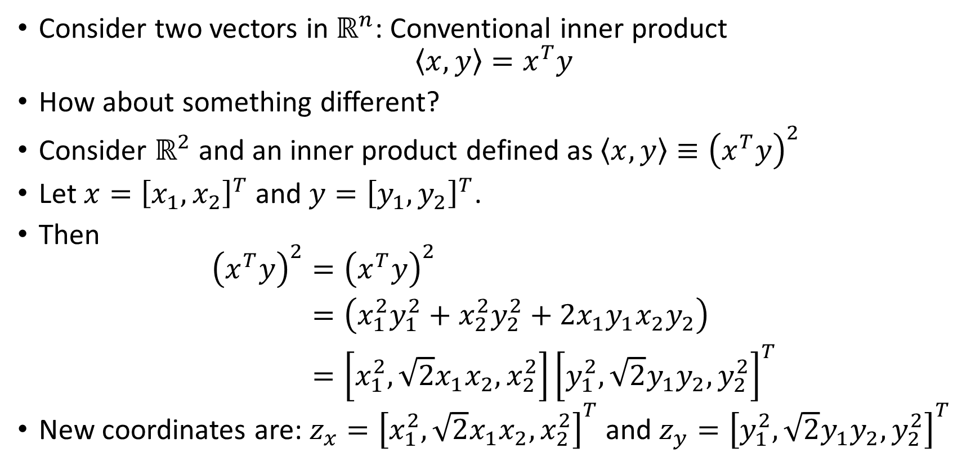
Overloading the inner product
Consider two vectors in $ℝ^{n}$: Conventional inner product
$$\left\langle x,y\right\rangle =x^{T}y$$
How about something different?
Consider $ℝ^{2}$ and an inner product defined as $\left\langle x,y\right\rangle ≡{\left(x^{T}y\right)}^{2}$
Let $x={\left[x_{1},x_{2}\right]}^{T}$ and $y={\left[y_{1},y_{2}\right]}^{T}$.
Then
$$\begin{aligned}{\left(x^{T}y\right)}^{2}&={\left(x^{T}y\right)}^{2} \\ &=\left(x_{1}^{2}y_{1}^{2}+x_{2}^{2}y_{2}^{2}+2x_{1}y_{1}x_{2}y_{2}\right) \\ &=\left[x_{1}^{2},\sqrt{2}x_{1}x_{2},x_{2}^{2}\right]{\left[y_{1}^{2},\sqrt{2}y_{1}y_{2},y_{2}^{2}\right]}^{T}\end{aligned}$$
New coordinates are: $z_{x}={\left[x_{1}^{2},\sqrt{2}x_{1}x_{2},x_{2}^{2}\right]}^{T}$ and $z_{y}={\left[y_{1}^{2},\sqrt{2}y_{1}y_{2},y_{2}^{2}\right]}^{T}$

Slide 3
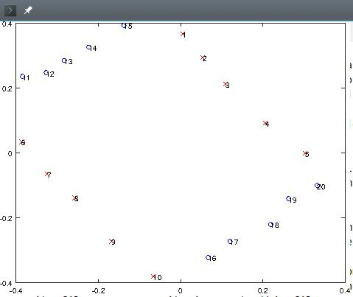
An Example

Slide 4
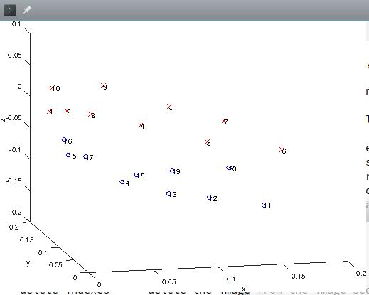
Transformation to 3D

Slide 5
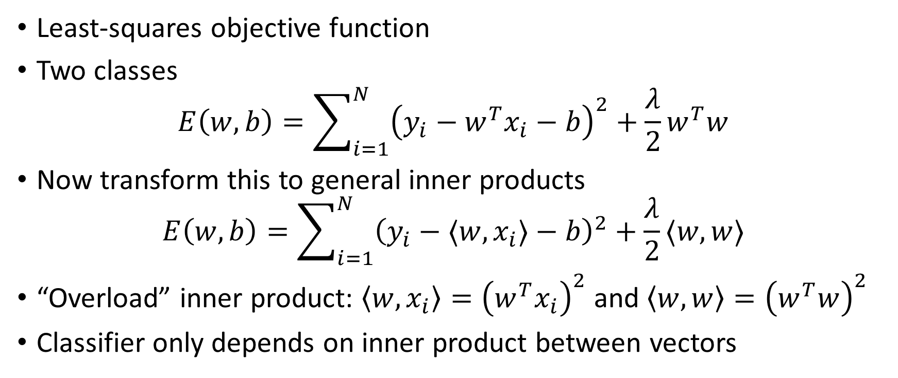
Importance of Inner Product
Least-squares objective function
Two classes
$$E\left(w,b\right)=\sum_{i=1}^{N}{{\left(y_{i}−w^{T}x_{i}−b\right)}^{2}+\frac{λ}{2}w^{T}w}$$
Now transform this to general inner products
$$E\left(w,b\right)=\sum_{i=1}^{N}{{\left(y_{i}−⟨w,x_{i}⟩−b\right)}^{2}+\frac{λ}{2}⟨w,w⟩}$$
“Overload” inner product: $\left\langle w,x_{i}\right\rangle ={\left(w^{T}x_{i}\right)}^{2}$ and $\left\langle w,w\right\rangle ={\left(w^{T}w\right)}^{2}$
Classifier only depends on inner product between vectors

Slide 6
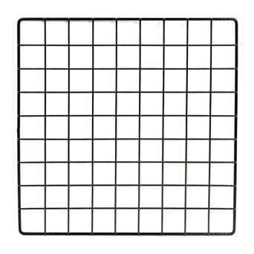
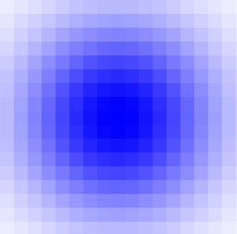
Hilbert Space: Every location as a dimension
Place a 2D Gaussian at pattern location
Gaussian leaks out into nearby “dimensions”
Number of Gaussians increases as grid lines inc.

